Slide 1

Customer Satisfaction in the Restaurant Industry
MANASA RAJAGOPAL MADABUSHI
APPALA DHANUSH BALIREDDY
MARYIN VEGA URRUTIA

Slide 2

Introduction
This study explores factors influencing customer satisfaction in the restaurant industry, analyzing various attributes related to customer demographics, dining preferences, and restaurant services. The research aims to identify key predictors of high customer satisfaction, focusing on food quality, service, and overall dining experience. By utilizing data mining techniques such as Naive Bayes, logistic regression, and decision trees, the study provides insights for optimizing customer satisfaction and improving service delivery in the restaurant sector.

Slide 3
Project Overview and Research Questions
This study examines factors influencing restaurant customer satisfaction and the likelihood of returning. It explores key drivers of satisfaction, service element combinations affecting repeat visits, and how customer demographics and behaviors impact positive reviews. The analysis covers dining aspects such as food quality, service, ambiance, and wait time.
Research questions include: 1. What factors influence customer satisfaction in restaurants? 2. What service combinations lead to the highest satisfaction? 3. How do demographics and behaviors affect returning and positive feedback?
1
Customer Loyalty
Understanding key satisfaction factors helps improve customer retention
2
Data-Driven Improvements
Insights enable restaurants to enhance operational efficiency
3
Competitive Edge
Tailoring services based on findings helps maintain market advantage

Slide 4
Related Work and Literature Review
Previous research in the restaurant industry highlights key factors driving customer loyalty. Han and Ryu (2009) found that pleasant atmosphere and high-quality service significantly influence customer satisfaction and return likelihood. Namkung and Jang (2008) emphasized food quality's role in boosting satisfaction and repeat patronage.
Rust and Zahorik (1993) noted that retaining customers is more cost-effective than acquiring new ones. Liu and Jang (2009) showed that demographics like age and income shape customer expectations. These insights suggest that tailoring offerings based on customer preferences can improve satisfaction and retention.
2009
2008
1993
2009
Han and Ryu: Atmosphere and service quality impact satisfaction
Namkung and Jang: Food quality boosts satisfaction and repeat visits
Rust and Zahorik: Customer retention more cost-effective than acquisition
Liu and Jang: Demographics shape customer expectations

Slide 5
Dataset Description and Preprocessing
The dataset includes restaurant customer satisfaction data, covering demographics (age, income, gender), dining preferences, visit frequency, spending, and ratings on service, food, and ambiance. Additional factors like group size, dining occasion, and online reservations are also recorded.
Data cleaning and preprocessing steps included: - Handling missing data: Critical fields like ratings were imputed, non-essential missing data excluded - Outlier detection: Outliers in service and food ratings flagged - Normalization and encoding: Categorical variables encoded, continuous variables normalized
Demographics
Dining Preferences
Ratings
Age, income, gender
Visit frequency, spending, group size
Service, food, ambiance

Slide 6
Exploratory Analysis
Initial insights from descriptive statistics and visualizations revealed key trends in customer satisfaction. Higher customer satisfaction was strongly associated with positive ratings in service quality and food experience. Restaurants offering diverse dining options and amenities, such as loyalty programs or quick service times, demonstrated higher levels of customer engagement and repeat visits.
These preliminary findings suggest that focusing on improving service and food quality, alongside enhancing the overall dining experience, could lead to increased customer retention and satisfaction. The analysis provides a foundation for more in-depth statistical modeling to identify specific factors influencing customer satisfaction.
Service Quality
Food Experience
Strong correlation with overall satisfaction
Key driver of positive customer ratings
Dining Options
Loyalty Programs
Diverse offerings increase engagement
Associated with higher repeat visits

Slide 7




Factors Influencing Customer Satisfaction
A decision tree model was used to identify primary factors influencing customer satisfaction. The process involved data retrieval, handling missing values, attribute generation, and conversion of nominal to numerical data. 'High Satisfaction' was set as the target variable, with predictors including food, service, ambiance ratings, and wait time.
The model achieved 84% accuracy, performing well in predicting non-returning customers (precision: 86.79%, recall: 95.83%). However, it struggled with predicting returning customers (precision: 38.46%, recall: 15.15%), indicating a potential class imbalance or need for model improvement.
Data Preparation
Retrieval, cleaning, and attribute generation
Model Application
Decision tree to identify key satisfaction factors
Performance Evaluation
Accuracy assessment and confusion matrix analysis

Slide 8
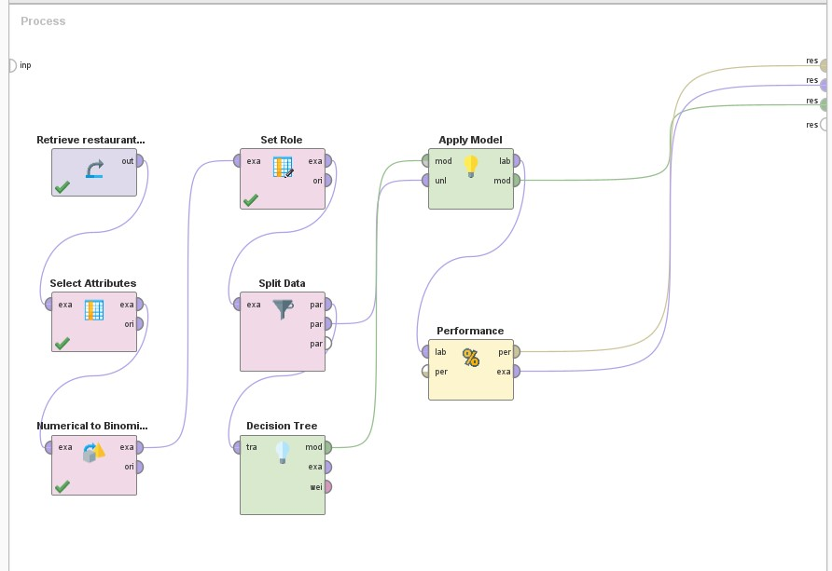
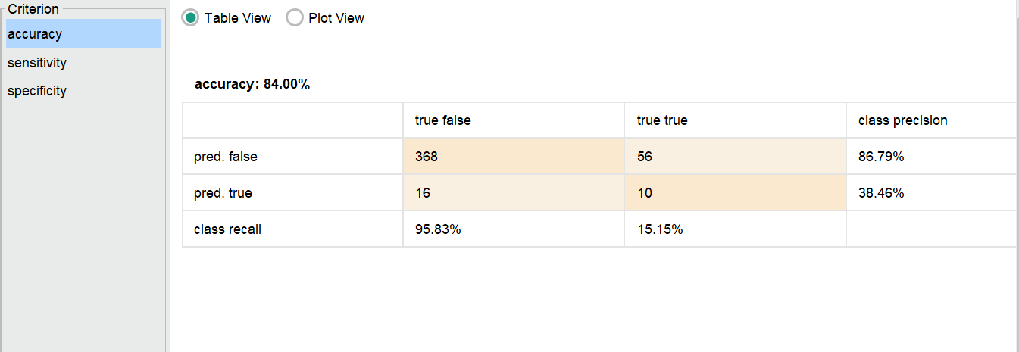
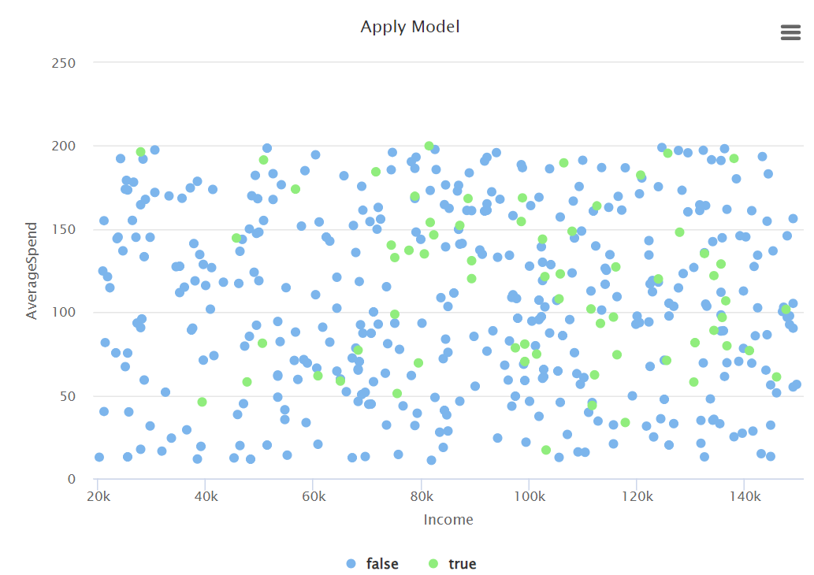
Decision Tree Model Process, Performance Metrics, and Visualization

Slide 9

Service Combinations for Highest Satisfaction
Logistic regression was used to identify service factor combinations leading to high customer satisfaction. The process involved data retrieval, handling missing values, creating combined attributes, and encoding categorical variables. 'High customer satisfaction' was set as the target variable, with service factors as predictors.
The model achieved 82.67% accuracy, performing well in predicting the negative class (precision: 90.14%, recall: 89.95%). However, it struggled with predicting high customer satisfaction (precision: 32.85%, recall: 33.33%), indicating difficulty in correctly identifying instances of high satisfaction.
Model Accuracy
82.67%
Negative Class Precision
90.14%
Negative Class Recall
89.95%
Positive Class Precision
32.85%
Positive Class Recall
33.33%

Slide 10
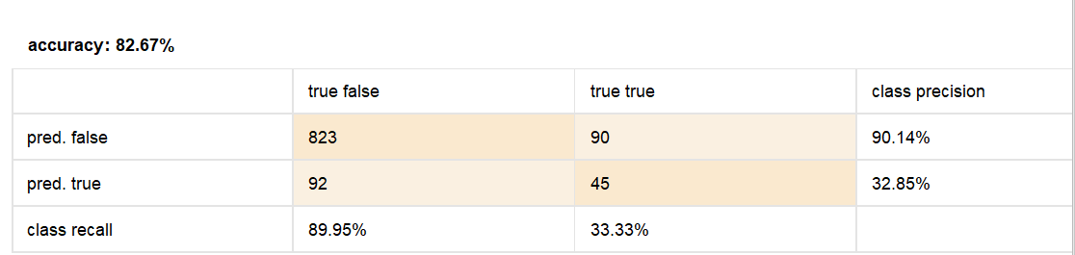
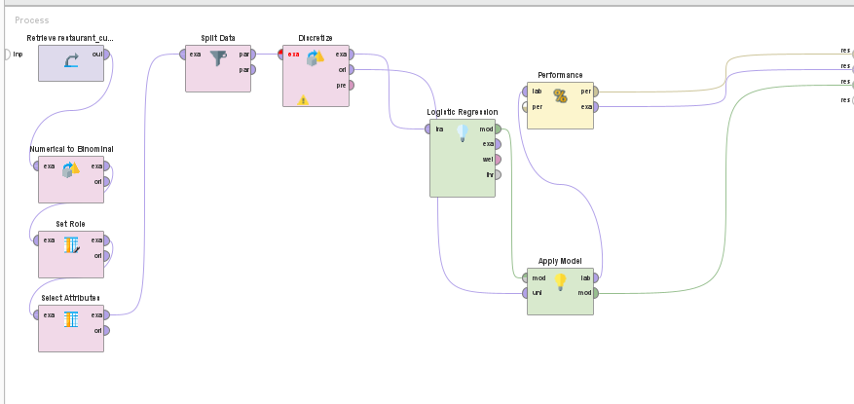
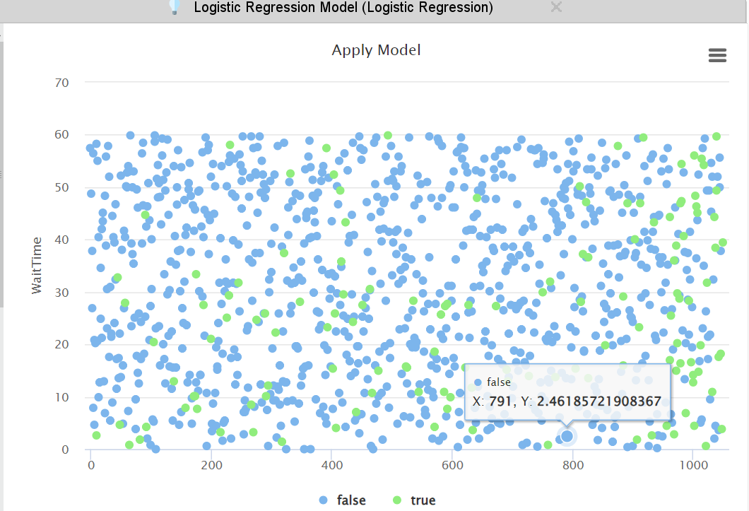
Logistic Regression Process, Performance Metrics and Visualization

Slide 11





Impact of Demographics and Behaviors
A Naive Bayes classifier was used to analyze how customer demographics and behaviors affect their likelihood of returning or leaving positive feedback. The process involved collecting demographic and behavioral data, imputing missing values, creating variables like "frequent visitor" and "loyalty member", and transforming categorical variables into numerical values.
The model achieved 90.13% accuracy, performing well in predicting guests who do not return (precision: 90.33%, recall: 99.23%). However, it struggled with predicting return stays (recall: 31.34%), indicating difficulty in accurately identifying rebooking behavior.
Age
Demographic factor influencing satisfaction
Income
Economic indicator affecting dining choices
Visit Frequency
Behavioral metric for customer loyalty
Group Size
Social factor impacting dining experience

Slide 12
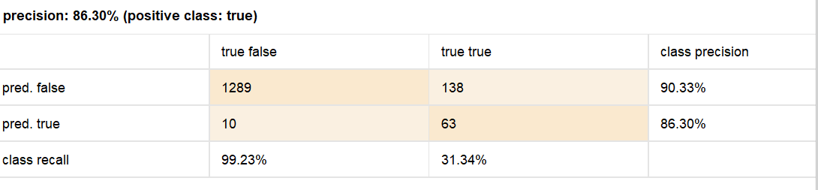
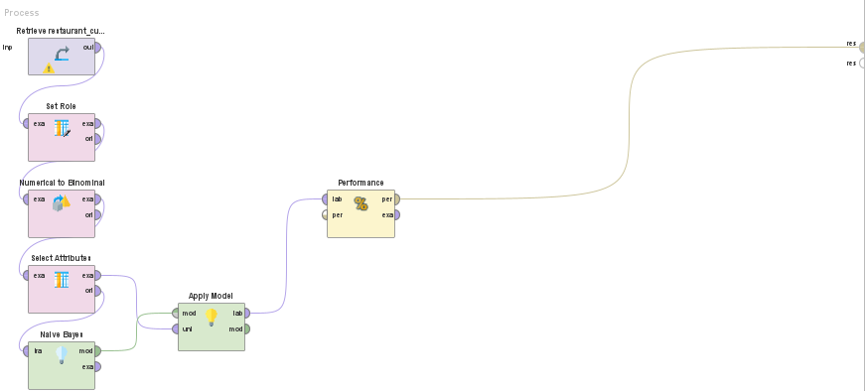
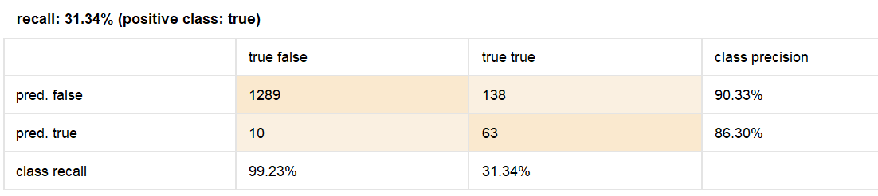
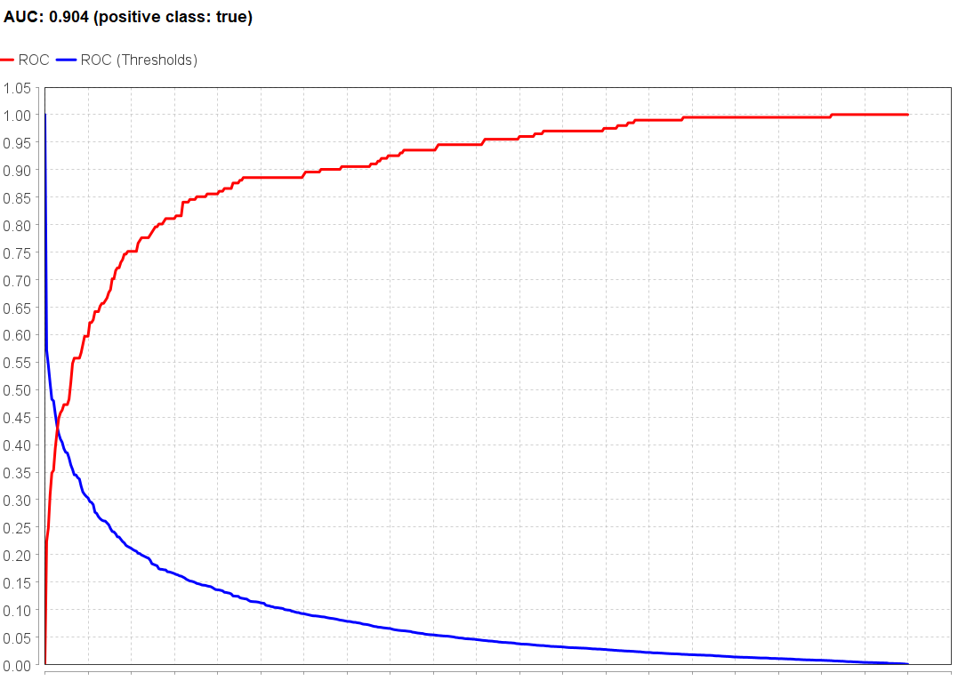
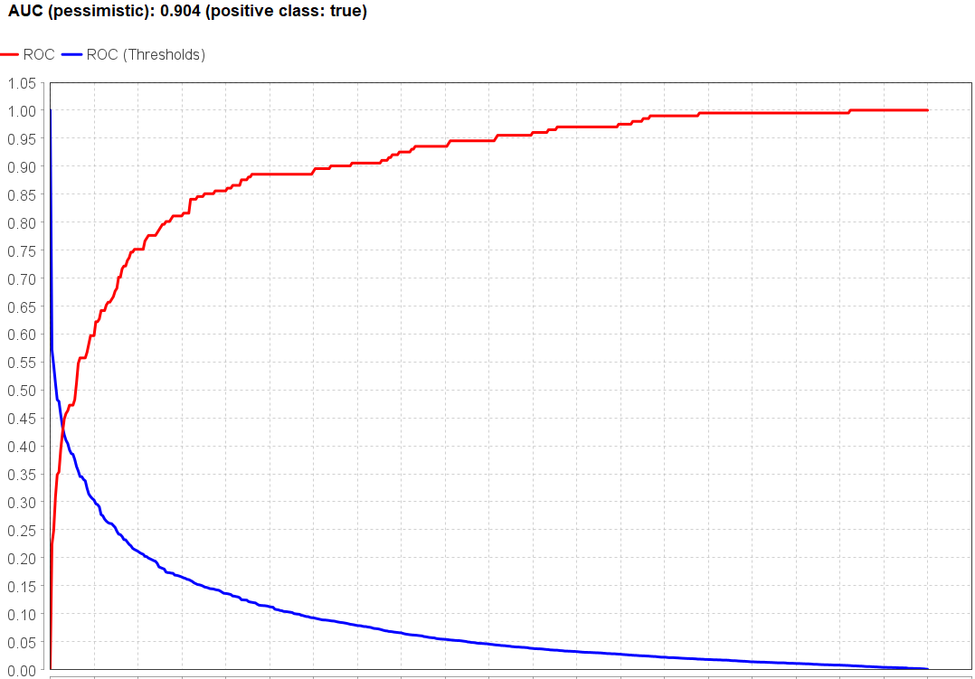
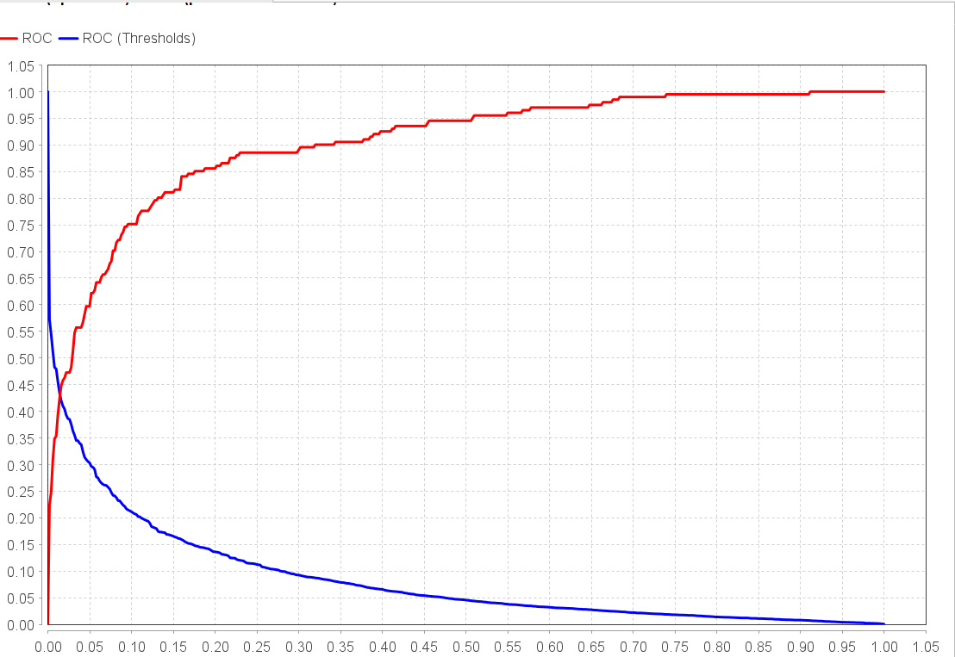
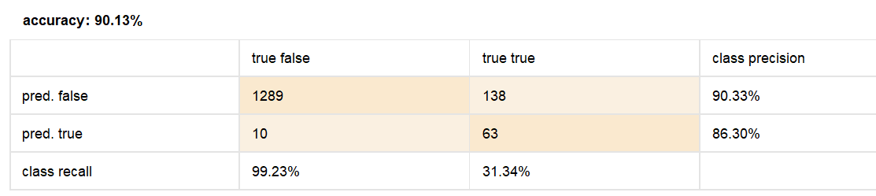
Naive Bayes Classification, Performance Metrics(Precision, Recall, AUC)

Slide 13



Conclusion and Future Directions
The analysis revealed that service quality, food rating, ambiance, and wait time are key drivers of customer satisfaction. A combination of excellent service and high-quality food significantly enhances the dining experience, increasing the likelihood of customer satisfaction and return visits. While demographic factors like income and visit frequency affect retention and feedback, the overall dining experience has a stronger impact on satisfaction.
Future research should use larger, more diverse datasets and advanced machine learning techniques to better capture complex interactions and improve predictive accuracy. Including more detailed feedback and external factors could enhance the analysis and provide more comprehensive insights for restaurant owners and managers.
Improved Customer Experience
Advanced Analytics
Comprehensive Data
Focus on service quality and food enhances satisfaction
Future research to use more sophisticated techniques
Larger, more diverse datasets for better insights

Slide 14
References
Han, H., & Ryu, K. (2009). The roles of the physical environment, price perception, and customer satisfaction in determining customer loyalty in the restaurant industry. Journal of Hospitality & Tourism Research, 33(4), 487-510. https://doi.org/10.1177/1096348009344212
Namkung, Y., & Jang, S. (2008). Are highly satisfied restaurant customers really different? A quality perception perspective. International Journal of Contemporary Hospitality Management, 20(2), 142-155.https://doi.org/10.1108/09596110810852131
Rust, R. T., & Zahorik, A. J. (1993). Customer satisfaction, customer retention, and market share. Journal of Retailing, 69(2), 193-215.https://doi.org/10.1016/0022-4359(93)90003-2
Liu, Y., & Jang, S. (2009). The effects of dining atmospherics: An extended Mehrabian-Russell model. International Journal of Hospitality Management, 28(4), 494-503. https://doi.org/10.1016/j.ijhm.2009.01.002

